Slide 1
Chatbot
Retrieval-Augmented Generation (RAG)

Slide 2
Abstract
This project implements a sophisticated RAG (Retrieval Augmented Generation) system capable of processing multiple document types including PDFs, Word documents, Excel files, and web content.
The system employs a graph-based workflow with specialized agents for document retrieval and web search that collaborate intelligently based on confidence scores.
A dedicated Excel-to-SQL pipeline enables natural language querying of tabular data, allowing users to ask complex analytical questions in plain language.
The implementation includes efficient document chunking, BM25 reranking, vector indexing with FAISS, and response caching to enhance both speed and relevance.
A modern, responsive Streamlit frontend provides intuitive tools for document uploading, URL submission, document chat, and data analysis through a unified interface.

Slide 3
Introduction
Traditional document search systems often struggle with understanding context, handling multiple file formats, and providing natural language responses, creating inefficiencies in information retrieval and data analysis workflows.
This RAG (Retrieval Augmented Generation) system combines advanced document processing, vector search, LLM capabilities, and data analysis to provide contextually relevant answers from mixed document sources.
Built on a Python backend with FastAPI, the system integrates embedding models, vector databases, LLMs, and SQL processing to create a comprehensive information retrieval pipeline.
The project features a confidence-based agent routing system, SQL generation from natural language, and unified processing of both structured and unstructured data sources.
By enabling natural language interaction with documents and data, the system dramatically reduces time spent searching for information and analyzing data, allowing users to focus on insights rather than query formulation.

Slide 4
Key Objectives
Provide accurate and context-aware responses
Support multiple data sources:
Structured (Excel/SQL)
Unstructured (PDF/DOCX)
Dynamic (Web)
Enable interactive querying via a user-friendly frontend
Incorporate evaluation metrics for response quality
Cache responses for efficiency

Slide 5
Core Components
RAG Module
Vector Search with FAISS
BM25 for reranking
Groq LLM for answer generation
Excel Processor
Converts Excel to SQLite
Natural language query to SQL query translation
Web Search
Tavily API for real-time search
Evaluation
Hallucination
Context Precision

Slide 6
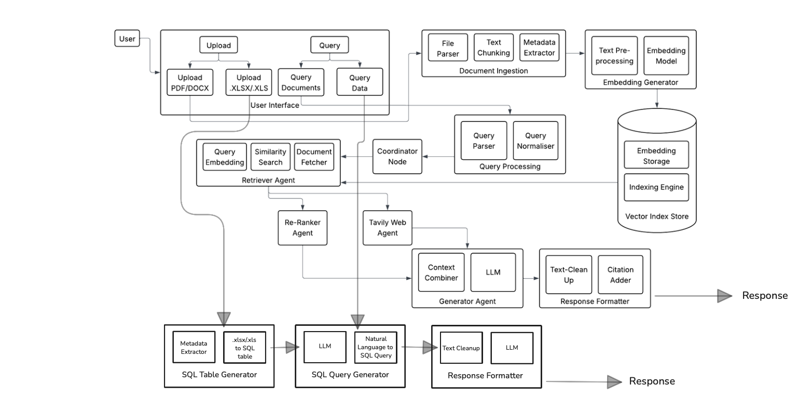
System Design

Slide 7
Conclusion
Developed a modular RAG system integrating document retrieval, Excel querying, and web search with FastAPI and Streamlit.
Supports intuitive querying of PDFs, DOCX, Excel tables, and web content using Grok for accurate, context-aware responses.
Leverages FAISS, BM25 reranking, and caching to deliver fast, relevant results with high confidence.
LangGraph-based agent intelligently selects document or web-based answers based on a 0.6 confidence threshold and evaluates the response provided by the LLM.
Streamlit frontend offers seamless file uploads, URL submission, and chat-based querying for enhanced usability.

